Slide 1
Software Architecture
Course’s Code: CSE 483
Design Patterns in Software Development
(Chapter 1)

Slide 2
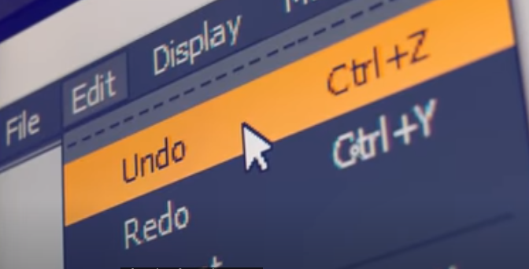
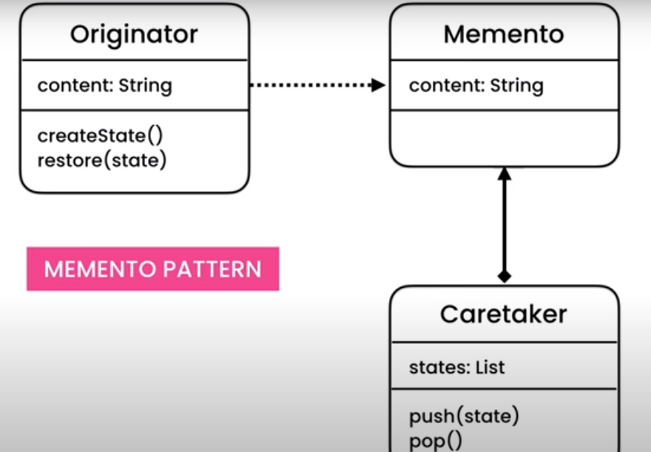
The Power of Design Pattern
What is design pattern?
For example, making undo mechanisms in your application
This is an example of repeating problem in software design
Different design patterns can be used to implement this feature
Design patterns tell us how to structure classes and how those classes should talk to each other.

Slide 3
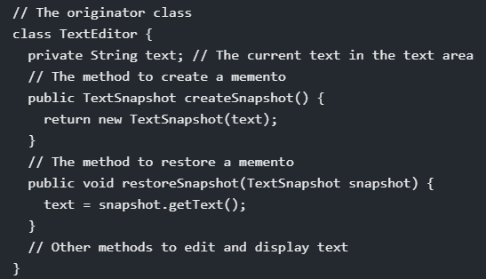
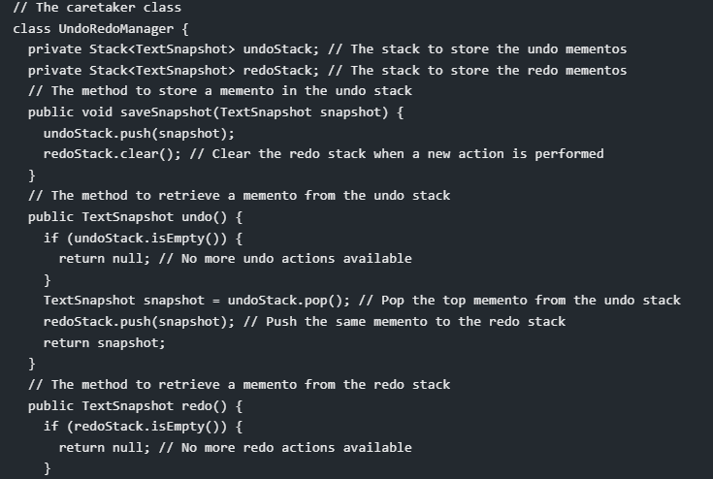
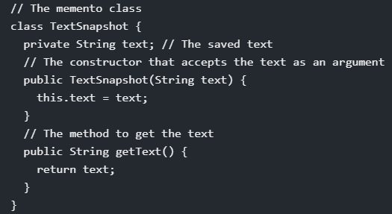
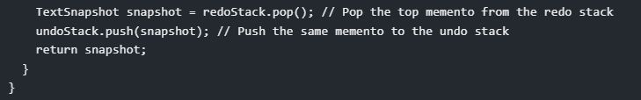
An example of Using Memento Pattern

Slide 4
Design Pattern
What is design pattern?
Design pattern not associated with any programming language
Solution to a common (repetitive) problems
It’s about object creation and interactions

Slide 5
Design Pattern
Design pattern has 3 main characteristics:
1. Specific to a particular scenario
2. Evolved to provide the best solutions
3. The remedy for the problems under consideration.

Slide 6
Benefits of using Design Pattern
Why Should we use Design Patterns?
  Vocabulary to talk about design: Design Patterns can help us to communicate with other developers in more abstract level
  For example, you can tell your coworker, “Hey we can use this Façade Pattern to improve this code”
  You just need to name of the design pattern to communicate your idea
  You do not need to write a lots of code to express your idea

Slide 7
Benefits of using Design Pattern
    It helps you to make a better designer
  Elements of reusable design: You can learn how to make
  reusable, extensible and maintainable software, no matter what
  kind of programming language you have used or what kind of
  application you have created.
  This help you to learn any frameworks quickly, since same
  design patterns are used in various frameworks and libraries

Slide 8
Chapter 1
Chapter 1. Design Patterns in Software Development
1.1 Classic GOF software design patterns
1.2 Enterprise architecture patterns

Slide 9
Common GoF Design Patterns
The Gang of Four (GoF) patterns are 23 classic software design patterns providing recurring solutions to common problems in software design. They help solve common problems in object-oriented design.
These patterns described in the book: Design Patterns: Elements of Reusable Object-Oriented Software.
These patterns classified into 3 groups:
  Creational patterns: Different ways of creating objects. Control object creation, initialization and class selection.
  Structural patterns: organizing relationship between classes and objects. Providing guidelines for combining and using related objects to achieve design behaviors.
  Behavioral patterns: control communication, messaging and interaction between objects.

Slide 10
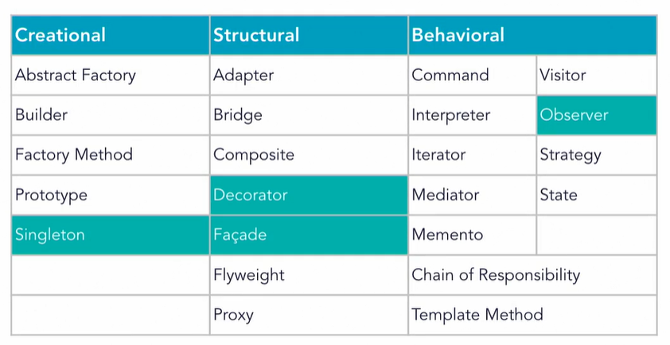
Common GoF Design Patterns

Slide 11
Creational Design Patterns
Creational patterns: Different ways of creating objects.
This category are:
Abstract Factory: Creates an instance of several families of classes
Builder: Separates object construction from its representation
Factory Method: Creates an instance of several derived classes
Object Pool: Avoid expensive acquisition and release of resources by recycling objects that are no longer in use
Prototype: A fully initialized instance to be copied or cloned
Singleton: A class of which only a single instance can exist

Slide 12
Structural Design Patterns
Structural patterns: organizing relationship between classes and objects.
This category are:
Adapter. Allows for two incompatible classes to work together
by wrapping an interface around one of the existing classes.
Bridge. Decouples an abstraction so two classes can vary
independently.
Composite. Takes a group of objects into a single object.
Decorator. Allows for an object’s behavior to be extended
dynamically at run time.
Facade. Provides a simple interface to a more complex
underlying object.
Flyweight. Reduces the cost of complex object models.
Proxy. Provides a placeholder interface to an underlying object
to control access, reduce cost, or reduce complexity.

Slide 13
Behavioral Design Patterns
Behavioral patterns: the interaction and responsibility of objects.
This category are:
Chain of Responsibility. avoid coupling the sender of a request to its receiver by giving multiple objects a chance to handle the request.
Command. Create objects which encapsulate actions and parameters.
Interpreter. define a representation of grammar of a given language, along with an interpreter that uses this representation to interpret sentences in the language.
Iterator. Accesses the elements of an object sequentially without exposing its underlying representation.
Mediator. define an object that encapsulates how a set of objects interact.
Memento. restore the state of an object to its previous state.
Observer. define a one-to-one dependency so that when one object changes state, all its dependents are notified and updated automatically
State. the class behavior changes based on its state.
Strategy. defines a family of functionality, encapsulate each one, and make them interchangeable
Template. define the skeleton of a function in an operation, deferring some steps to its subclasses
Visitor. Separate an algorithm from an object structure by moving the hierarchy of methods into one object

Slide 14
Chapter 1
Chapter 1. Design Patterns in Software Development
1.1 Classic GOF software design patterns
1.2 Enterprise architectural patterns

Slide 15
Enterprise Architecture Patterns (JEE)
Solution to Enterprise software problems
Java EE Patterns: documented in Sun’s Java Blueprints
Follow the flow of message through a system to the next system via paths, redirection and transformations.
Patterns classified by Application Layer:
  Design patterns at the Presentation Layer
  Design patterns at the Business Layer
  Design patterns at the Integration Layer
Users
Presentation
Application Layer
Business
Integration

Slide 16
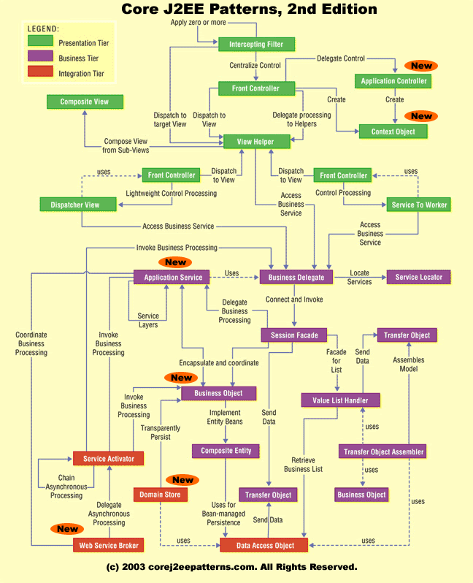
Enterprise Architecture Patterns (JEE)
Presentation Layer Design Patterns
  Intercepting Filter Pattern
  Front Controller Pattern
  View Helper Pattern
  Composite View Pattern
2. Business Layer Design Patterns
  Business Delegate Pattern
  Service Locator Pattern
  Session Facade Pattern
  Transfer Object Pattern
3. Integration Layer Design Patterns
  Data Access Object Pattern
  Web Service Broker Pattern

